Slide 1

FLIGHT
INFO DIRECT
ACCELERATE YOUR COMMERCIAL STRATEGY WITH READY-TO-QUERY AVIATION DATA

Slide 2


ONGOING DATA CHALLENGES
Traditional databases, the backbone of enterprise computing, were not designed to centralize, integrate, analyse and share extensive quantities of data
Data living in multiple silos is difficult to combine and time consuming to streamline
No single source of truth, inability to share/consume data across multiple departments
Manual effort involved with downloading and extracting relevant insights from the data is a resource constraint

Slide 3

If only there was a better way to consume aviation data...

Slide 4

Flight Info Direct gives direct access to ready-to-query, high-quality OAG aviation data in the cloud. Smoothly integrate it with your own internal systems or a variety of business applications.

Slide 5
GAME CHANGING TECHNOLOGY
Reduce time to insight Get faster data to accelerate analyses and decision making. Our customers save hours on a weekly basis.
Improve operational efficiencies You can eliminate ongoing data engineering, software updates and the manual downloading and uploading of files with real-time datasets
For the first time ever seen by the industry, users can directly connect to OAG’s database for instant access to aviation data. Game changer.
Minimize operational challenges Securely assessing the latest data to avoid possible manual errors and data corruption
Customizable to you See all global flights or customize to see only what you care about. Configure by carrier, region, date and more.
Seamlessly Integrated Integrate our data warehouse to your own systems and pull what you need automatically, or connect with BI tools such as Tableau.

Slide 6










SAY GOODBYE TO DATA SILOS
Passenger Booking Data
Status
Schedules
Connections
Emissions
Master Data
FLIGHT INFO DIRECT
Internal Data
3rd party data
Fleet Data
MCT Data
© 2022 OAG Aviation Worldwide Limited. All rights reserved
WWW.OAG.COM

Slide 7
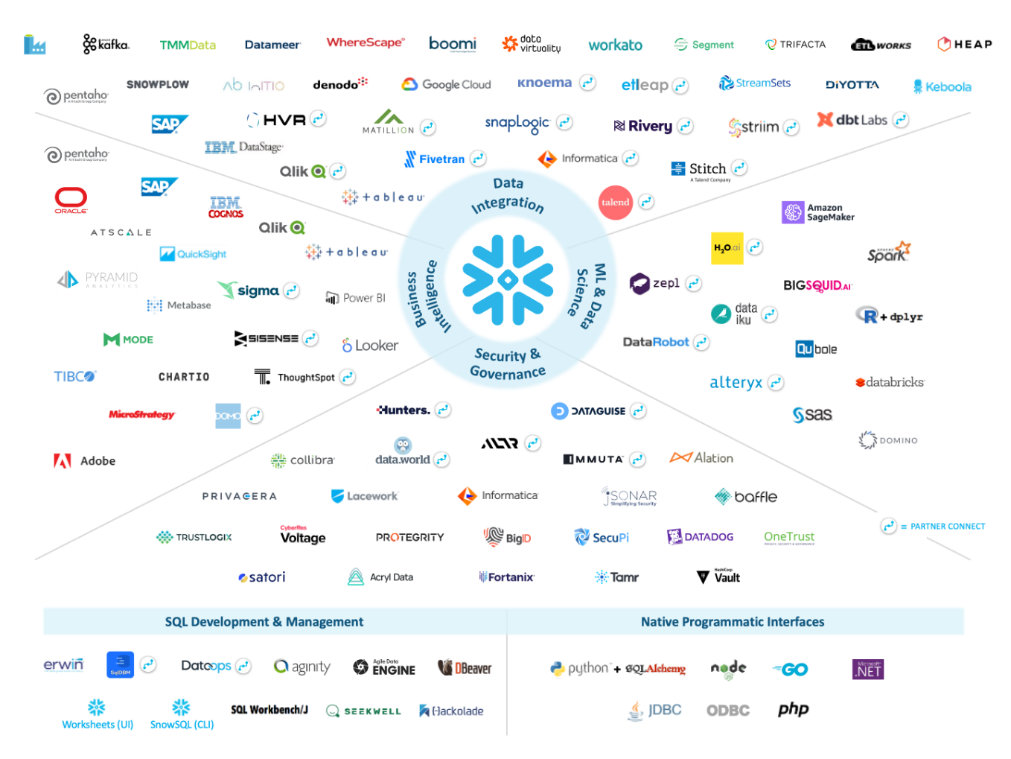
Connect our data to your preferred systems – endless possibilities

Slide 8

What data is available?

Slide 9


GLOBAL AIRLINE SCHEDULES
The most accurate airline schedules database on the market, giving you access to commercial airline schedules, aircraft configurations, minimum connection times and flight schedule changes.
Geographic Coverage
Global
Data Sources
Airlines
GDSs
Data Time Range
Jan 2019 - 2 years forward
Data Frequency
Daily
Configurable by
Carrier
Geography
Combinations (e.g. carriers in JAPAC)
Key Data Points
Operating and Marketing Flights
Aircraft Type
Service & Meals
Core Flight Schedule Data (carrier, flight number, dep/arr times and airports, date etc.)

Slide 10

FLIGHT STATUS DATA
Tracking thousands of flights, cancellations and status changes every day to bring you a comprehensive feed of the most accurate flight status data. Eliminate complicated and disjointed data silos and track the entire lifecycle of the flight, from when the schedule was published until touchdown at the final destination.
Geographic Coverage
Global
Data Sources
Airports
Airlines
FAA
ADS-B
Data Time Range
Historical: January 2017 Operational: 52hr prior to departure – 48hr after arrival
Data Frequency
Daily
Configurable by
Carrier
Route
Flight Number
Airport
Key Data Points Estimated and actual timeliness (early, on time or delayed)
Estimated and actual variation Flight State (Scheduled, OutGate, InAir, Landed, InGate, Cancelled or Diverted)
Aircraft Type, Tail Number and Airport Codes (IATA & ICAO)

Slide 11


FLIGHT SEATS DATA*
Gain the most accurate forward view of flight seats data possible through our new data model which provides cabin availability data in First, Business, Premium Economy, Economy+ and Economy. Also get access to data on airplane seating and capacity for improved planning.
Geographic Coverage
Global
Data Sources
OAG Labs
Data Time Range
Forward-looking Predictions
Actuals back to Feb 2021
Predictions back to Jan 2019
Data Frequency
Daily
Configurable by
Carrier
Route
Key Data Points
Total Seats
Seats by Cabin
*Can be added-on with Schedules or Status.

Slide 12


GLOBAL CONNECTIONS DATA
Get direct access to a weekly produced global view, which includes schedule data with 1 year validity for all passenger flights worldwide - that's more than 200 million single connections in one view
Geographic Coverage
Global
Data Sources
Airlines
Alliances & 3rd party
Data Time Range
1 year forward
Data Frequency
Weekly
Configurable by
Region
Dep/Arr Date
Carrier
Key Data Points
Online, Interline and Offline Connections
Single connections
Inter-Airport Connections
Elapsed Time

Slide 13

EMISSIONS DATA
Predict the fuel burn and emissions of scheduled flights based on the aircraft type, engine type and typical fuel consumption.
Geographic Coverage
Global
Data Sources
OAG
EASA
Data Time Range
2019-1 year forward
Data Frequency
Monthly
Configurable by
Carrier
Route
Aircraft
Key Data Points
Fuel Burn (tonnes) by flight, flight stage and seat
Carbon Emissions (tonnes) by flight, flight stage and seat
Flight Stages: Taxi out, take off, climb, cruise, approach and taxi in.

Slide 14

MASTER DATA
Industry codes provide universal abbreviations to facilitate travel and enable a common language to be interpreted and understood across systems all over the world. They are typically 1, 2, 3, or 4-character combinations that uniquely identify locations, equipment, carriers, and times to standardize international flight operations.
Geographic Coverage
Global
Data Sources
IATA
ICAO
Data Frequency
Daily
Key Data Points
Airline Codes: 1,400 IATA Carrier Codes, shows Alliance Membership and Carrier Region
Location Codes: 5,000 IATA location codes, assigned to cities, countries, time zones and DST.
Equipment Codes: 500 IATA Aircraft Types, showing engine type and aircraft manufacturer.

Slide 15


PASSENGER BOOKING DATA
Access Passenger Booking Data at speed and scale in the cloud with Flight Info Direct. See number of passengers by cabin class and load factors for direct and connecting flights back to 2019. Analyze point of sale and where passengers originate, connect and end.
Geographic Coverage
Global
830+ carriers
Data Sources
GDSs
Data Time Range
Forward Looking: 1 year forward
Historical Adjusted: 2019-3 months after travel month
Data Frequency
Monthly
Configurable by
Region
Route
Carrier
Key Data Points
Point of Sale
Booking Class A-Z
Passengers Total
Connecting Airports
Distance Miles
Marketing & Operating Carrier
Load Factor

Slide 16

FLEET DATA
Aircraft fleet data provides valuable insights into aircraft performance, maintenance needs, fuel efficiency and airline commercial performance. With over 78,000 different aircraft and more than 13,000 operators currently tracked globally, find out how an aircraft changed operators during its lifetime, or analyze a specific operator’s fleet growth over time.
Data Fields
Aircraft Owner & Operator (owners, managers, IOSA certification, trusts and SVPs)
Aircraft Type (registration number, aircraft type and variant)
Aircraft Engine (engine manufacturer, engine type and subtype)
Status (active, stored, written off, not yet delivered, first flight etc)
Utilisation (flight hours/cycles, forecasted cycles, annual utilisation etc)
Aircraft Orders (order entity, date, cancellation date etc)
Data Views
Fleet
Ownership
History
Coverage
Global
Every commercial aircraft >19 seats
Time Range
Current view of the commercial leasing landscape
Historical up to 20 years
Frequency
Weekly
Monthly

Slide 17

MCT DATA
Flight connections make new destinations available to passengers and create new revenue opportunities through codesharing and interlining. With over 157,000 industry-standard Minimum Connections Times (MCTs) and airline-specific exceptions to keep track of, we help you ensure your offering is consistent across booking channels by using the most accurate and up to date flight schedules information.
Geographic Coverage
Global
Data Time Range
Snapshot of current MCT view
Refresh Frequency
Daily
History
First snapshot date 6th March 2024 Carrier
Key Data Points
Minimum Connection Times standards and exceptions in industry
standard format (IATA chapter 8)
– flight number range
– date range
– carrier codes
– terminal codes
– regions
– equipment
– departure/arrival airport and cities
– codesharing agreements (operating /marketing flights)

Slide 18

Flight Info Direct for Travel Tech
Scale Effortlessly and Streamline Data
Eliminate manual data processes and save time. Scale and expand as required with usage-based pricing.
High Quality and Customizable
With global flight coverage and a strict data quality process, we’re trusted both by start-ups and industry giants alike as a single source of truth. Easily configure your results by carrier, airport, date, region and more.
Seamlessly Integrated
Connect smoothly and automatically pull data into your own internal systems or integrate with a variety of data visualization tools such as Power BI and Tableau.

Slide 19

Flight Info Direct for Finance
Accelerate Search for Alpha
Unify traditional and alternative data to back test systematic strategies and minimize risk
Near Unlimited Capabilities
Forecast potential market performance with historical and forward-looking aviation data. Query hundreds of thousands of flights within minutes.
Data Security
Single cloud platform with cloud governance and access controls, infrastructure as code and private network access for all three clouds

Slide 20

Flight Info Direct for Airports
Allocate Appropriate Resource
Quickly and easily schedule operational resource by looking at forward looking schedules. Only allocate the amount of staff you’ll need, keeping passengers happy and reducing revenue loss.
Unlock Network Opportunities
Gain competitive intelligence to drive market insight and spot potential opportunities for route and network development.
Forecast Demand
Use historical data and forward looking schedules to model and forecast passenger flow, budgets and revenue. Analyse demand drivers to have a clear view on what’s happening medium-long term.

Slide 21


Don’t just take our word for it
– Compressed admin costs by 90%.
– Operating costs are near zero.
– 2X client ROI.
– Significant time saved.
– Risks minimized for customers.
– Increased customer transparency.
“Otonomi chose OAG over its competitors for its incredible flexibility in product offerings and solutions, despite being a global tier-1 player in the aviation space. Without OAG, we wouldn't have the right data, the right pricing or the right risk model for our insurance partners. Without OAG, there's no business."
“It’s all about the data storage. Access to the data in Snowflake made it easy for us to build a pipeline around. This was a game changer for us compared to other solutions on the market.
When considering different vendors, it was OAG’s coverage confidence, transparency and uptime that made them stand out, not to mention the support and technical documentation available. It’s so important for us to have accurate data that we can always access, which is why we selected OAG.”

Slide 22






Our Difference
VALIDATION
Bespoke processing to validate and cleanse data and ensure it meets OAG standards
INFRASTRUCTURE
Modern and secure platform, hosted in the OAG Metis cloud
EXPERTISE
Data complexity, system feeds and industry knowledge
90+ years
AGGREGRATOR
Hundreds of data sources, complex data at multiple stages of travel, various formats across different technologies put into an easy to consume format.
FLEXIBILITY
Usage and data freshness-based pricing, unique to your requirements
ENHANCEMENT
Value adding data elements e.g. seat config, terminals, locations, equipment, MCTs

Slide 23











You’re in good company

Slide 24

About Snowflake
Thousands of customers around the world now mobilize their data in ways previously unimaginable with Snowflake's cloud data platform - a solution for:
data warehousing
data lakes
data engineering
data science
data application development
data exchange
Snowflake provides the near-unlimited scale, concurrency, and performance our customers in a variety of industries want, while delivering a single data experience that spans multiple clouds and geographies.
For more information visit: www.snowflake.com
Snowflake Data Marketplace
Snowflake Data Marketplace gives data scientists, business intelligence and analytics professionals, and everyone who desires data-driven decision-making access to live and ready-to-query data from your ecosystem of business partners and customers, and from potentially thousands of data providers and data service providers.
Snowflake Data Cloud
More than 400 million SaaS data sets remain siloed, globally. Many more generated by daily business activity are similarly isolated in cloud data storage and in on-premises data centers.
The Data Cloud eliminates these barriers, enabling organizations to easily unify and connect to a single copy of all of their data. The Data Cloud is an ecosystem of thousands of organizations connecting to their own data and connecting to each other by seamlessly sharing and consuming shared data and data services.

